Slide 1
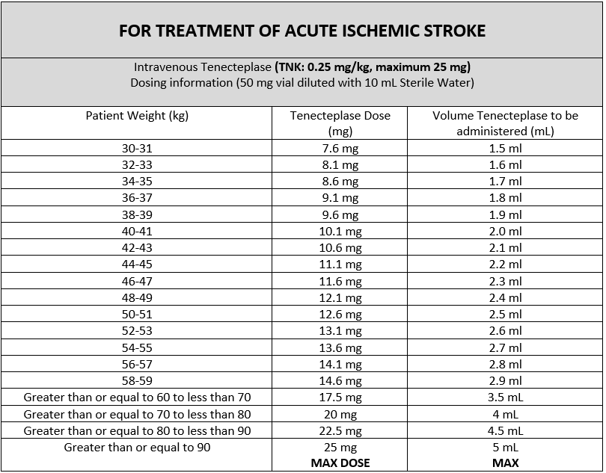
Tenecteplase (TNK) for Acute Ischemic Stroke
Trillium Health Partners will now be utilizing Tenecteplase (TNK) in addition to Alteplase (tPA) for the treatment of ischemic stroke
Tenecteplase (TNK) will be easier to prepare and administer. Only a bolus is needed. You no longer need to prepare an infusion as you do for alteplase (tPA)
All thrombolytic treatment indications, inclusion and exclusion criteria remain the same
Can be given up to 4.5 hours from onset of symptoms
Monitoring and care of the patient pre and post Tenecteplase (TNK) administration is the same as tPA
Dosing for Acute Ischemic Stroke is 0.25mg/kg (Max dose 25mg/dose) and is NOT the SAME as other indications i.e. Acute ST-Elevation Myocardial Infarction
Maximum Dosage of Tenecteplase for Acute Ischemic Stroke is 25 mg = 5 mL
Reconstitution of Tenecteplase TNK
Using 10 mL syringe and needle, withdraw 10 mL of Sterile Water from the supplied diluent vial
Inject all 10 mL of sterile water into the 50 mg Tenecteplase vial directing the water toward the side of the vial . Slight foaming is not unusual; any large bubbles will dissipate if the product is allowed to stand undisturbed.
GENTLY swirl the vial to mix completely. DO NOT SHAKE. Solution should be colourless or pale yellow and transparent.
Administration of Tenecteplase (TNK)
Determine the correct STROKE dose of Tenecteplase based on patient-weight band dosing. NOTE: Ensure you are using the appropriate size syringe (i.e. 3mL or 5mL)
Perform an independent double check with another qualified healthcare professional (nurse/physician)
Using an established IV site, flush with 20mL normal saline to ensure patency before Tenecteplase administration. NOTE: Do not mix Tenecteplase with any other medications or use any filters on IV tubing
Administer Tenecteplase as an IV Bolus push over 5 seconds
Flush with 20mL of normal saline following administration of Tenecteplase

